Slide 1
Title page
Youth crime in Canada
Institutional affiliation
Name of lecturer
Name of student
Due date

Slide 2
Introduction
Canada has experienced an increased crime rate among the youths as compared to the adults.
This makes 40% of crimes recorded on violent crimes and personal theft in the country.
This is higher than crimes recorded on adults, representing only 25% of the Canadian population committing the same crimes.
The age bracket with a higher crime rate in Canada is between 15 years and 19 years and are at risk of being victimized of criminal justice than those above 20 years.
Although the youths are more victimized and may be injured during violent crimes, 77% of the youth crimes are never reported to the police.
Notes:
However, the youth crime rate over the last decade has reduced significantly. Over the last decade, the charged youths were 21% fewer than 2000 (Allen & Superle 2016). The big question is, why do youths involved in crimes more than adults? Also, there are questions on why there is decreased crime rate among the youth over the past decade.

Slide 3
Causes of increased crime rate
The Canadian youths have experienced a higher crime rate due to various reasons.
First, violence in their social circles may have contributed to the increased crime rate among the youths.
When a person grows in violent environments, he/she takes those behaviours and thus become more prone to delinquency.
This is described as street survival as they have to navigate through the challenging social setting to ensure their survival.
Second, peer pressure is another cause of the increased crime rate among the youths in Canada.
This is similar to neighbourhood pressures that put youths at more risk of committing crime
Notes:
If a youth is surrounded by friends committing crimes, he/she is tempted to commit the same to be accepted in the group. This has made more youths commit crimes, thus increasing the crime rate among the youths in the country.

Slide 4
Cont.
The country's socioeconomic factors have contributed to the increased crime rate among the youths.
The youths are common in poorer neighbourhoods as compared to the wealthy areas.
Although all areas are not exempted from juvenile activities, the crime rate is increased in areas where the youths are socioeconomically pressed and thus will commit crimes to prosper.
Canada has mixed socioeconomic backgrounds ranging from poor to wealthy individuals.
The crime rate among youths is high in areas with low socioeconomic status.
Another reason for the increased crime rate is substance use and lack of moral guidance among the youths.
Notes:
Parental care and influence is an essential factor in growth and development of children. With many parents committed to their economic affairs, there is little interaction with their children and thus leaving them to copy unacceptable behaviours from their peers (Penney et al., 2010). This has left many youths at the risk of committing crimes and thus the cause of the increased crime rate among the youths.

Slide 5
Cont.
Lack of moral guidance is tied to substance use which has affected many youths, and they commit the crime under the influence of the drugs they abuse.
Research done on Canadian youth shows that substance use among the youths was three times higher than that of adults, and this has been a front cause of the high crime rate among the youths.
Other factors include poor education and school dropouts.

Slide 6
Reasons for reduced crime rate
Although Canada, for an extended period, has experienced a high crime rate among the youths, over the last two decades has experienced a decline in youth crime rate.
The crime severity has declined tremendously since 2000 to reach 103 in 2010 and 54.55 in 2019.
This is a sharp decline in the crime severity, although the country has not managed to eliminate the criminal activities among the youths (Cesaroni & Doob 2020).
The trend is associated with advanced age, a shift in unemployment rates and overall attitude change towards crimes.
Notes:
However, the government has put measures to eliminate causes of high crime rate among the youths like creating employment and thus the reduced severity in the last decade. With the continued trend, Canada may eliminate youth crime over the next 20 or 30 years.

Slide 7
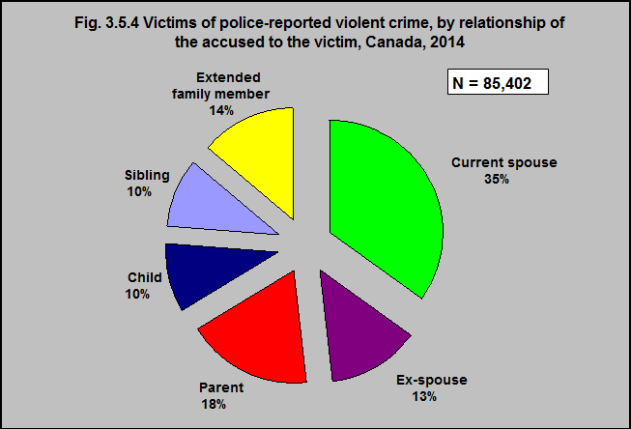
Reported youth crimes

Slide 8
References
Allen, M. K., & Superle, T. (2016). Youth crime in Canada, 2014. Juristat: Canadian Centre for Justice Statistics, 1.
Cesaroni, C., & Doob, A. N. (2020). Responding to youth crime in Canada. University of Toronto Press.
Penney, S. R., Lee, Z., & Moretti, M. M. (2010). Gender differences in risk factors for violence: An examination of the predictive validity of the Structured Assessment of Violence Risk in Youth. Aggressive behaviour, 36(6), 390-404.

